Slide 1
ACO
ANT COLONY OPTIMIZATION
Presented By
M. Furqan Hameed (sp19-bcs-029)
Bilal Bin mateen (sp19-bcs-030)

Slide 2
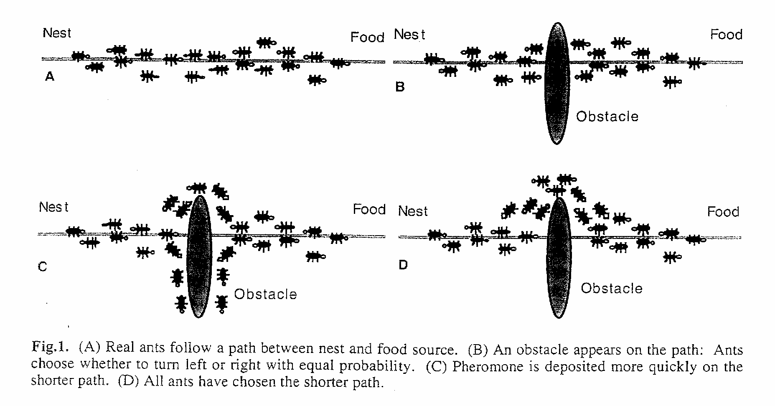

Slide 3
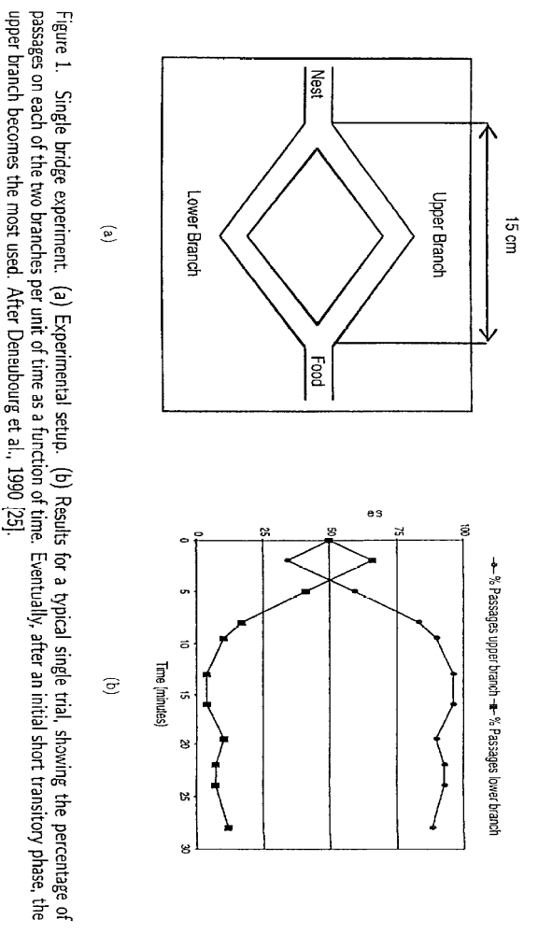

Slide 4
STIGMERGY
Indirectly communication shown by the status of the environment.
Available locally for agents (ants)
ANT ALGORITHM
A Multi-agent system which explores artificial stigmergy as a means to coordinate artificial ants to solve computational problems.

Slide 5
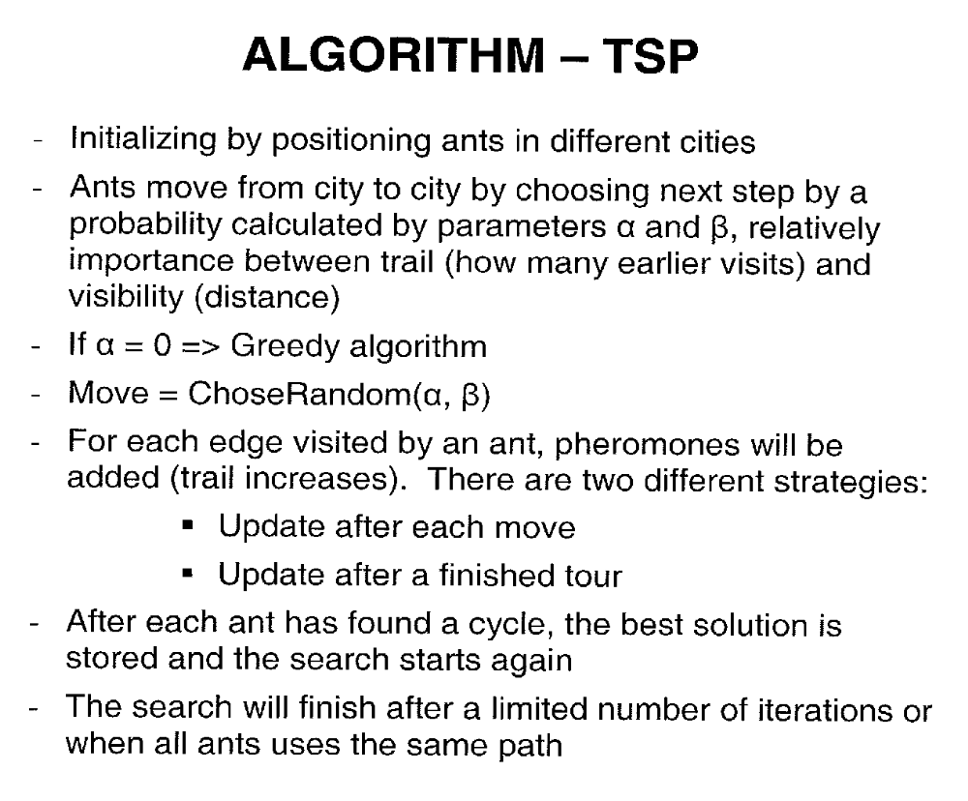

Slide 6
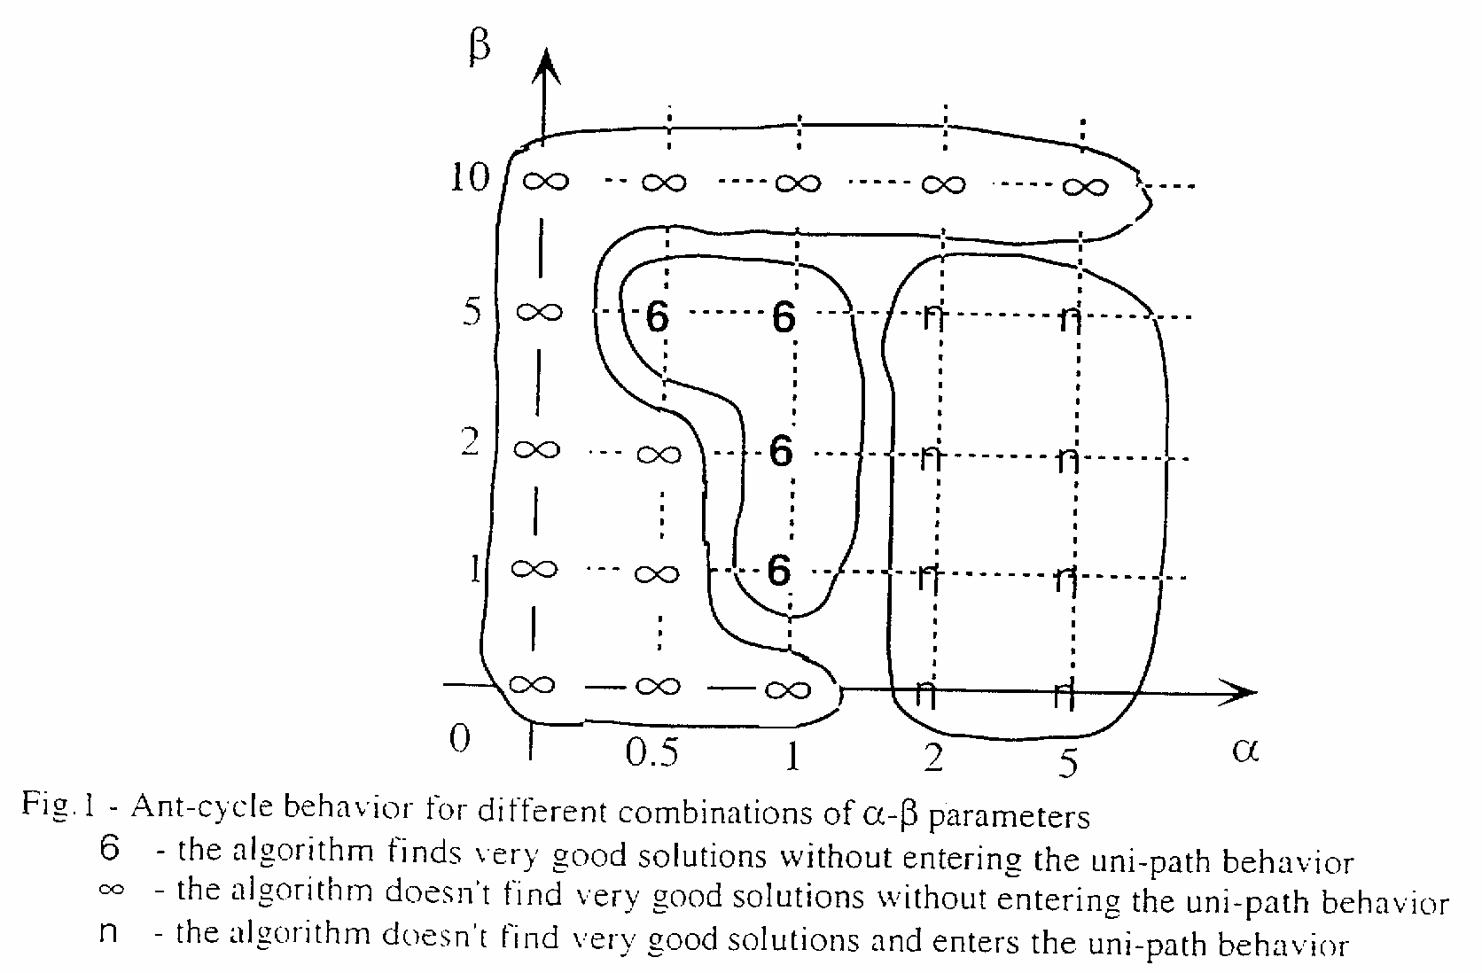

Slide 7
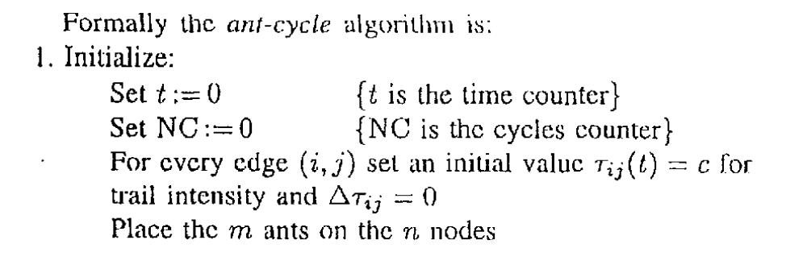

Slide 8
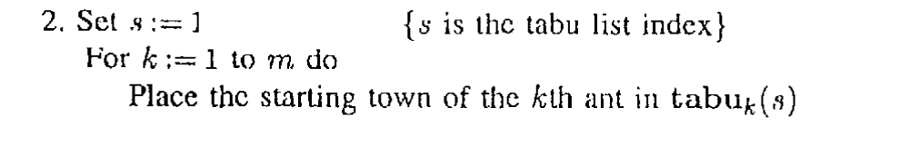

Slide 9
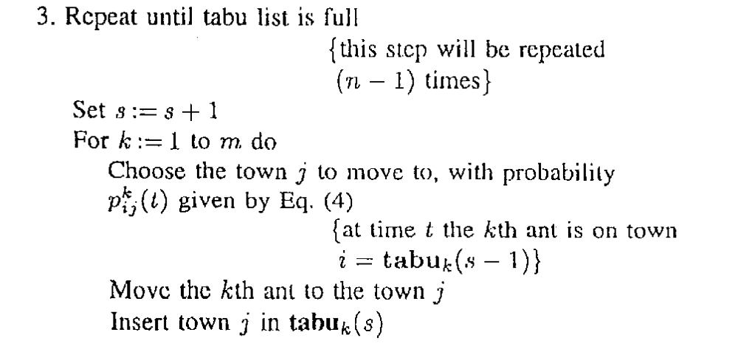

Slide 10
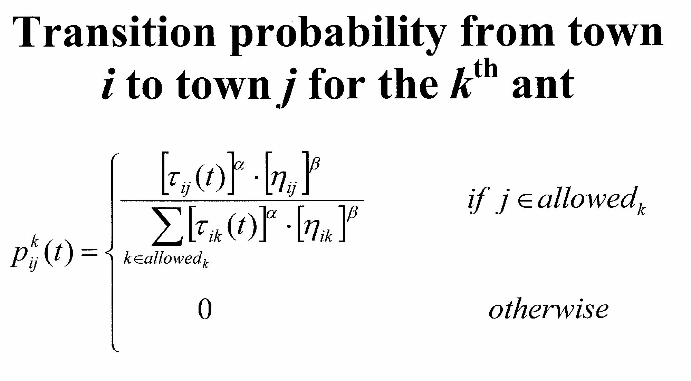

Slide 11
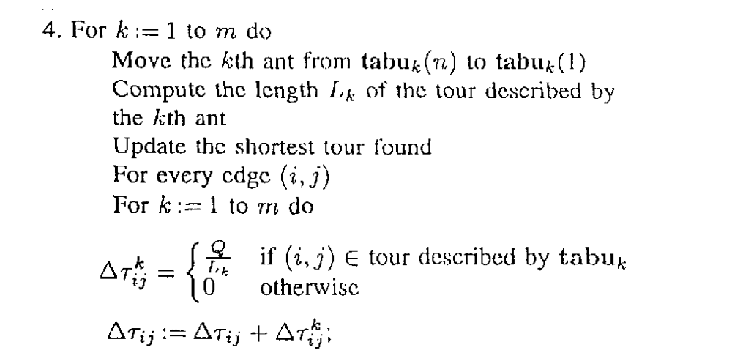

Slide 12
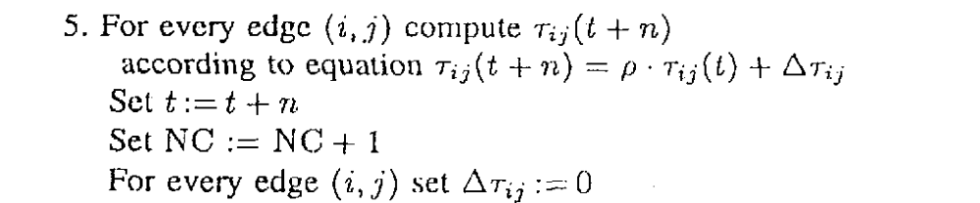

Slide 13
